Slide 1
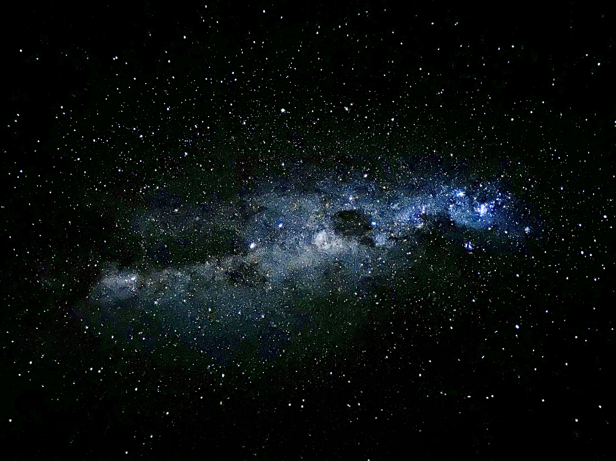
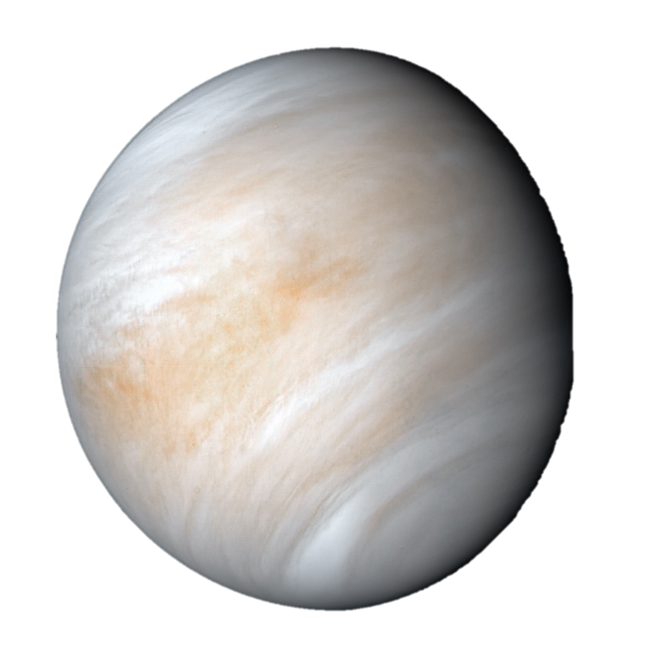
The Search for Life in Venus’ Atmosphere
SciXIgnite – Astro

Slide 2
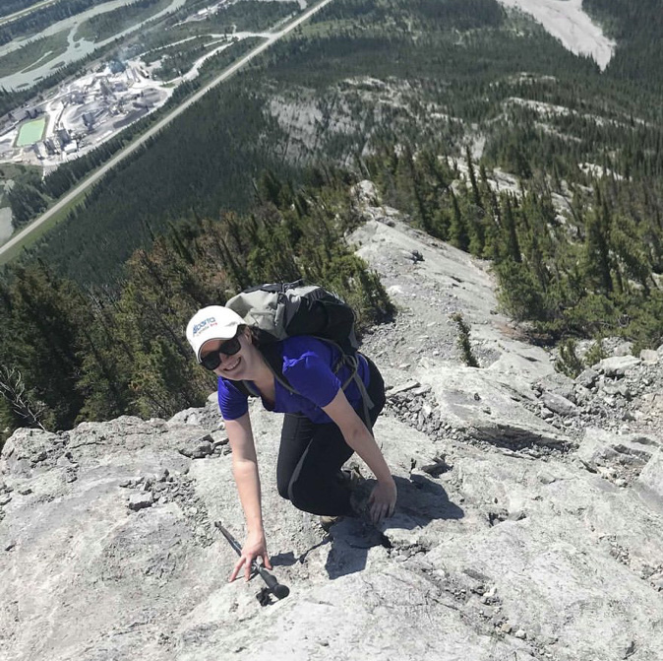





An introduction
I’m Maria and I’m from Canada!
Third-year PhD student at UNSW
Computational spectroscopy for the detectability of molecules in exoplanet atmospheres
Loves watching and reading Sci-fi
Birdwatcher and snorkeler

Slide 3
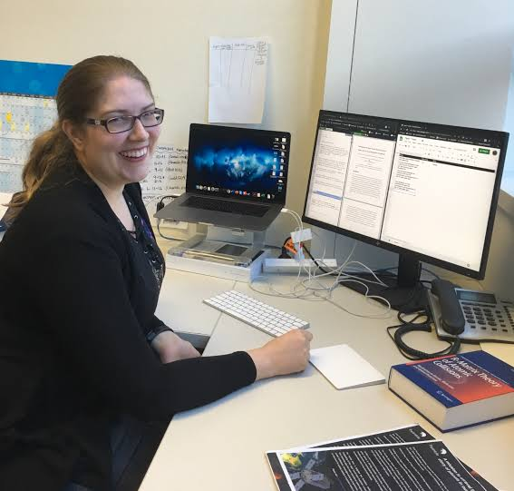





An Introduction
I’m Laura!
Senior lecturer at UNSW
Molecular physicist and computational quantum chemist!
Sci-fi and Harry Potter fan
Makes her own soap

Slide 4
You are going to simulate the scientific process of searching for life in Venus’ Atmosphere!

Slide 5






Biosignatures and the Search for Life
Notes:
When the exoplanet is detected by telescopes and then observed with telescopes capable of detecting infrared radiation, one of the questions is, what type of molecules are there and how are they produced? Volcano-type activity, geological processes, and even weather related events can bring molecules to the atmosphere. Even potentially life, with the important caveat that we need to look for molecules that are produced by life and not also produced via geochemistry.
With planets in our own solar system, like Mars or Venus, we can conceivably go to the planets and get physical samples of that atmosphere to charaterise. But with exoplanets outside our solar system, we can not do that! So instead, we use spectroscopy to gain information about what molecules are in the atmosphere.

Slide 6
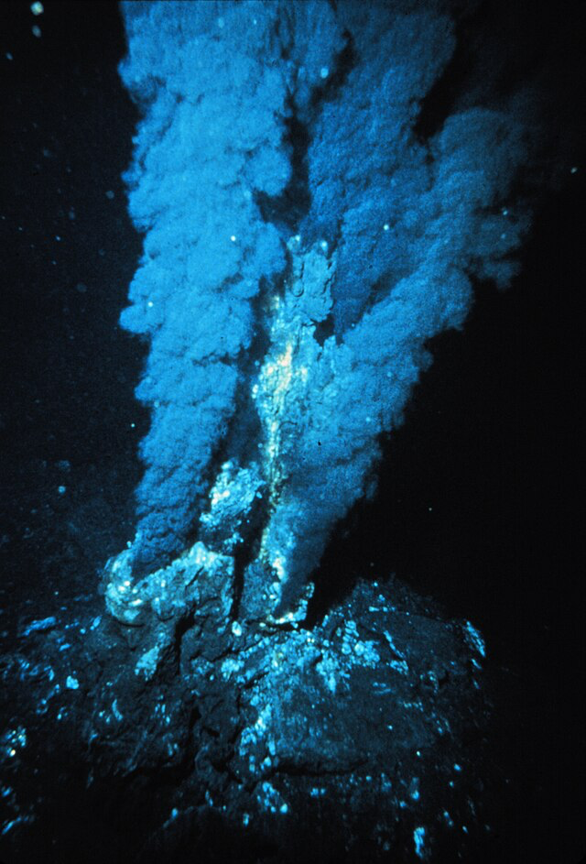
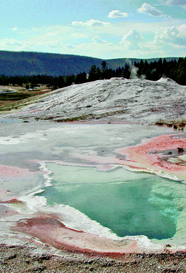
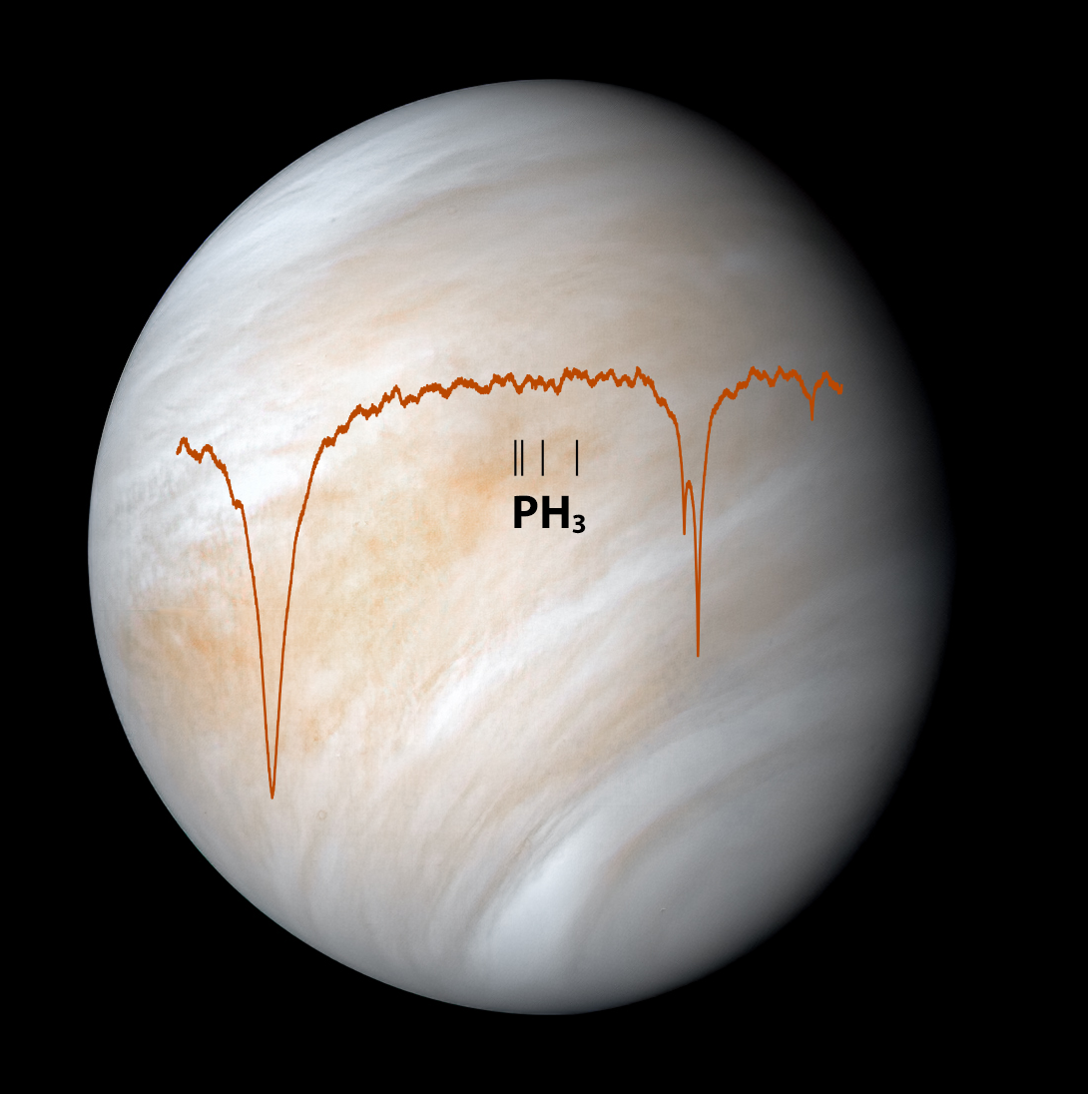
Signs of Life
Microbial Life
Fossil Life
Light Signal of Gas
Physical Evidence
Remote Signal Evidence

Slide 7
Definition of a Biosignature
"A biosignature is any phenomenon for which biological processes are a known possible explanation and whose potential abiotic causes have been reasonably explored and ruled out.”
We cannot rule out every alternative explanation with absolute certainty! Alternative explanations to a biosignature detection need to
be explored for a significant amount of time,
receive attention from a broad variety of people in the scientific community,
and a consensus must be met by the scientific community.
tldr; Time, attention, and consensus is needed by the scientific community!
Source: Gillen et al, 2023 http://doi.org/10.1089/ast.2023.0010

Slide 8
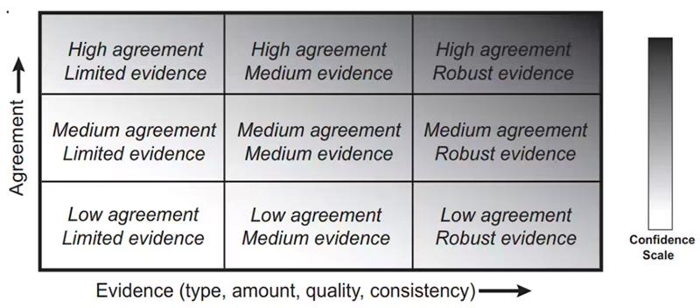
Levels of Certainty in Biosignatures
“Consensus of Scientific Community”

Slide 9
Potential Biosignatures
“A potential biosignature is any phenomenon for which biological processes are a known possible explanation but whose potential abiotic causes have not yet been reasonably explored and ruled out.”
All detections start as potential biosignatures and then are upgraded to biosignatures with
time,
attention,
and consensus,
by the scientific community!

Slide 10
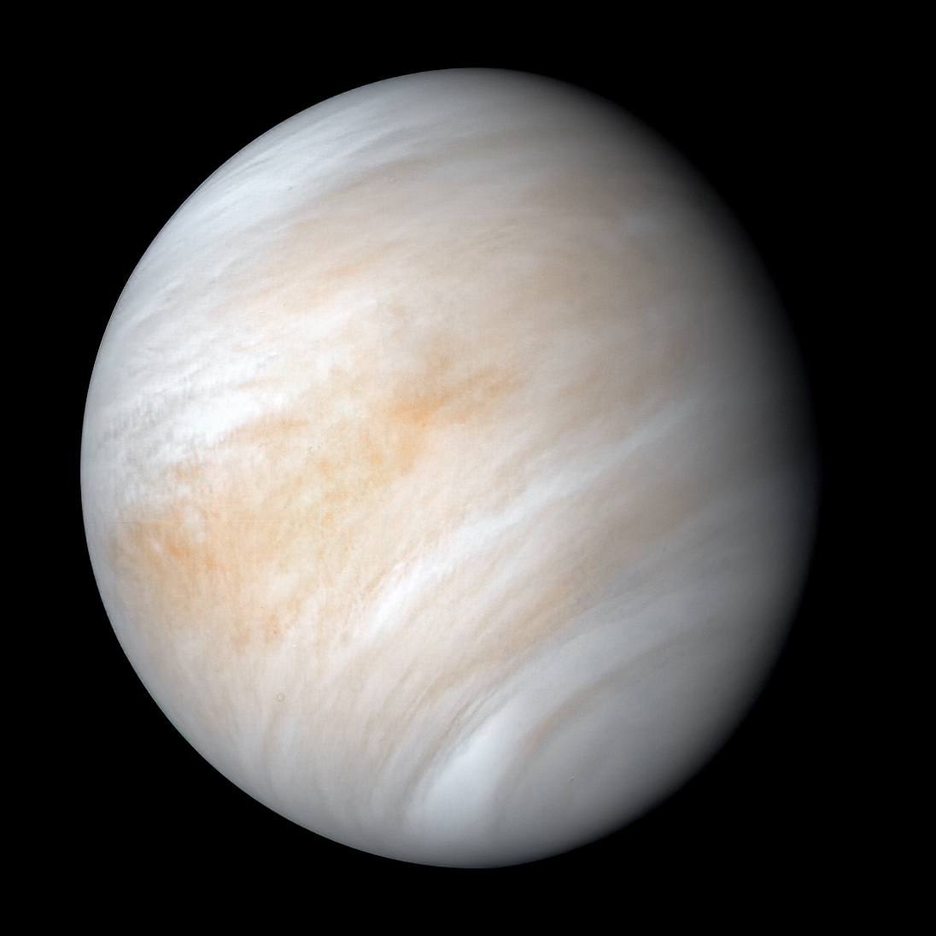
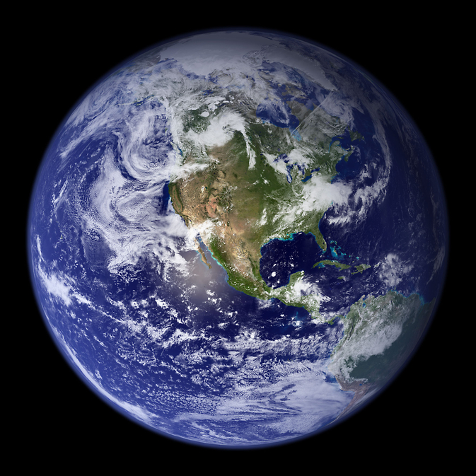
Earth’s Twin: Venus

Slide 11




Earth’s Twin: Venus
Venus is similar size to Earth
Its atmosphere 100 times more thick
Venus’ day is longer than its year
Surface temperature of 464 ℃

Slide 12
Phosphine is made by Earth Life
Phosphine is a molecule that is made of one phosphorous and three hydrogens.
On Earth, phosphine gas is generated by microbes in low-oxygen environments.
Scientists hypothesize microbial life could live in the upper cloud decks of Venus, where it is closer to Earth-like temperatures!

Slide 13
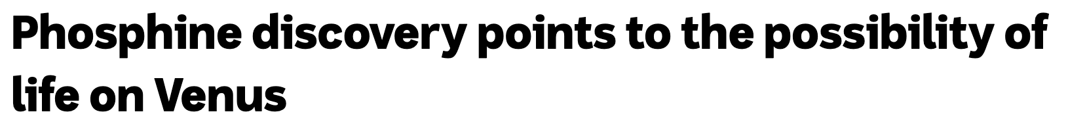
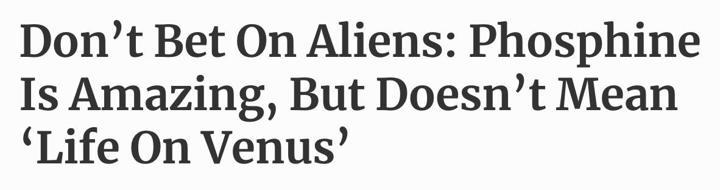
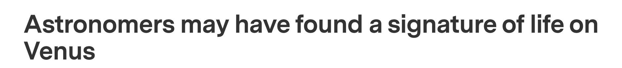
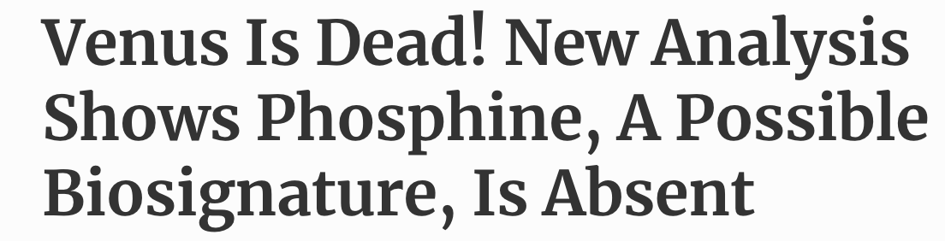


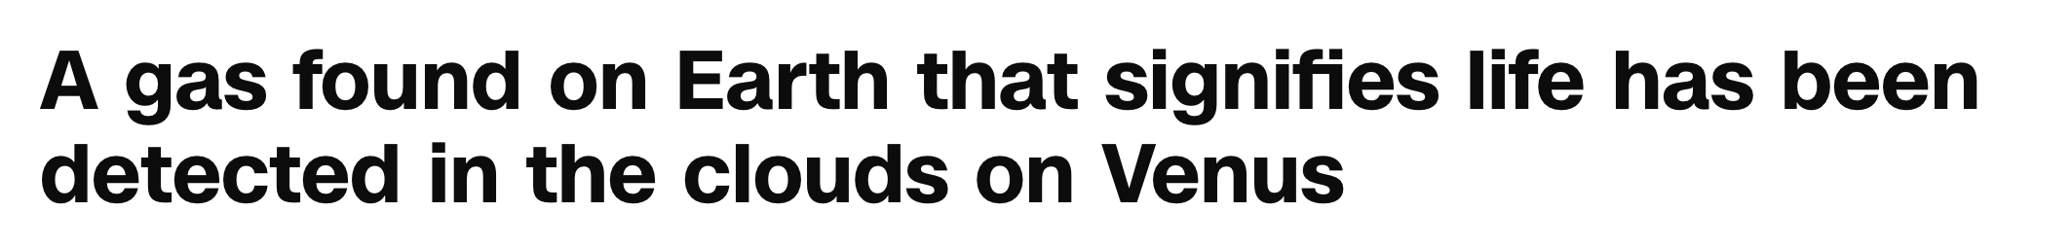
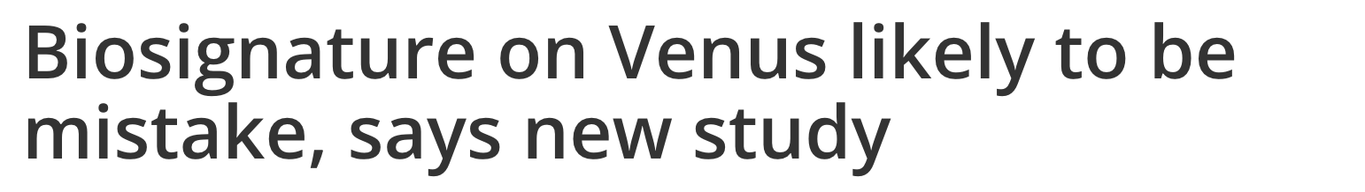
The Search for Phosphine

Slide 14
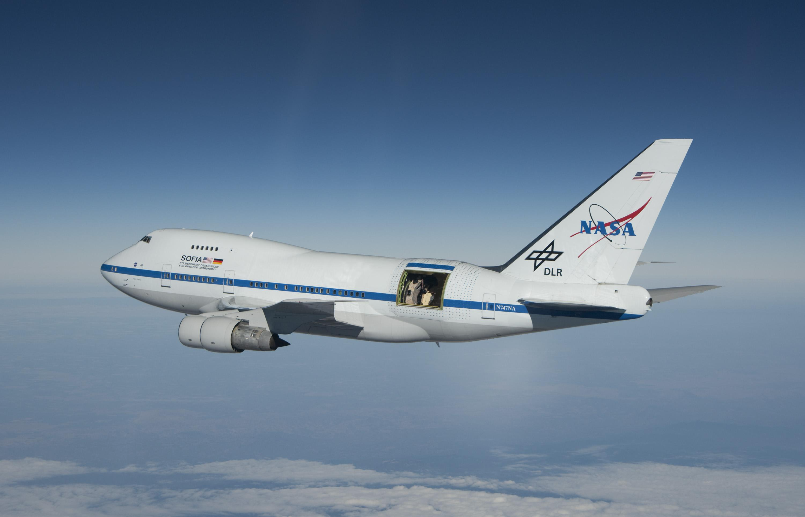
The Search for Phosphine
The search for phosphine in Venus’ atmosphere has been done by looking for the light signal of the gas.
This technique is called spectroscopy!
So far, the search or phosphine is inconclusive.

Slide 15
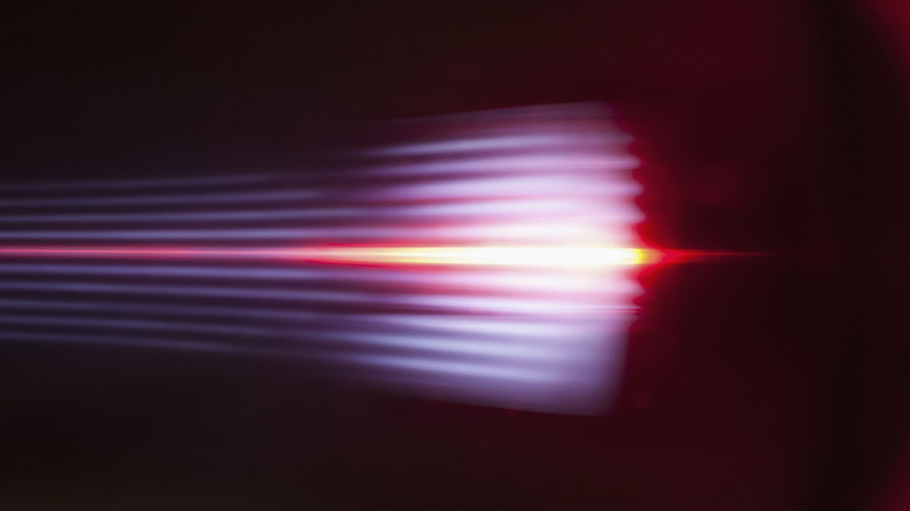
Spectroscopy:
The interaction between light and molecules

Slide 16
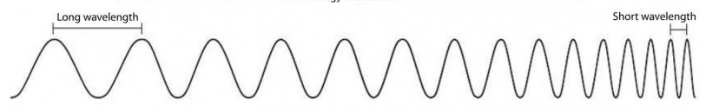

There’s no spectroscopy without electromagnetic (EM) radiation
Wavelength (m)
10⁻¹⁴
10⁻¹¹
10⁻⁸
10⁻⁵
10⁻²
1
10²
10⁵
10⁸
Gamma rays
UV
Infrared (IR) radiation
Microwaves
X rays
Radio waves
← Energy
When molecules absorb EM radiation, they undergo different kind of transitions between energy levels depending on the type of EM absorbed
Visible light
400 nm
700 nm

Slide 17
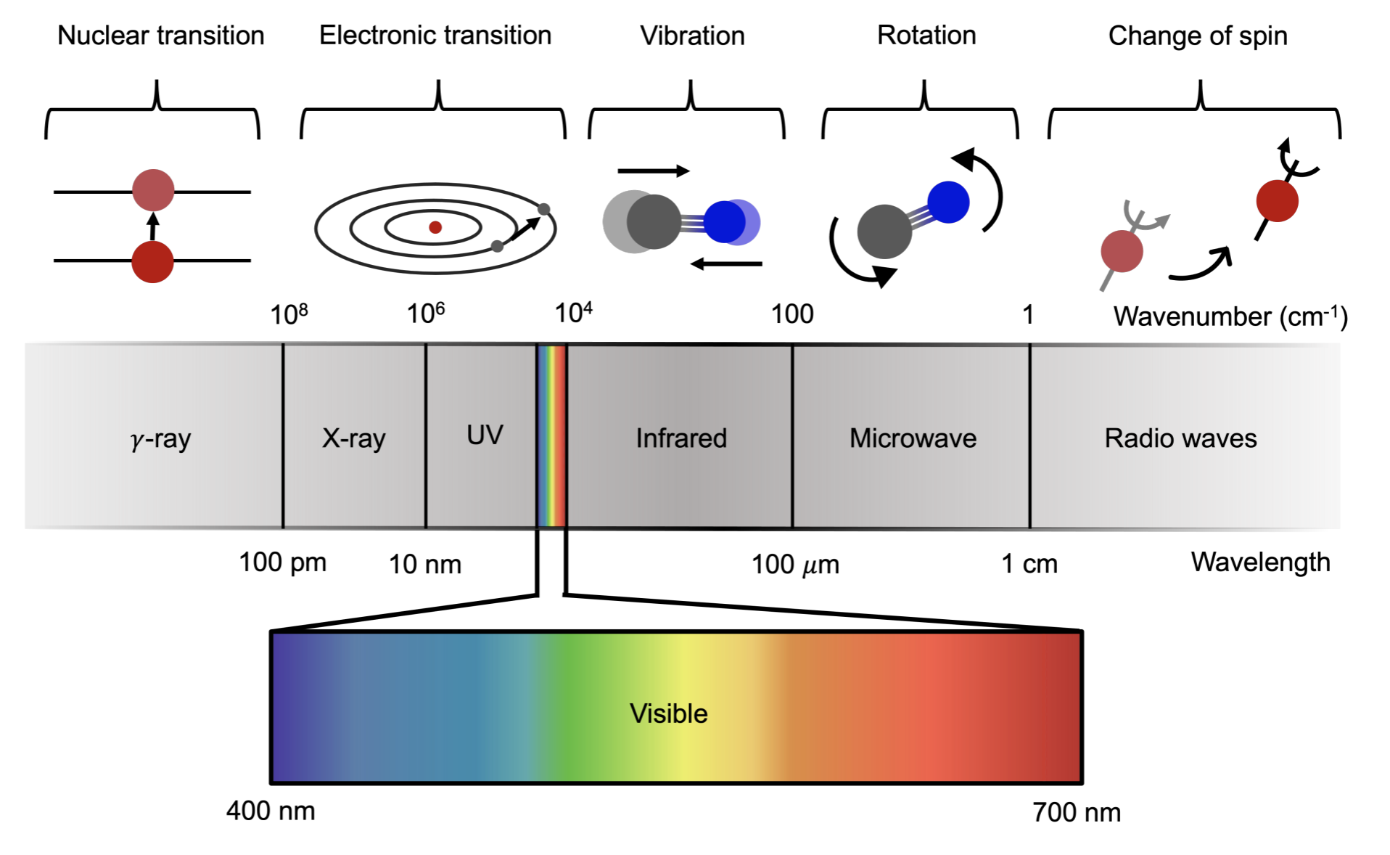
Types of transitions in atoms and molecules

Slide 18
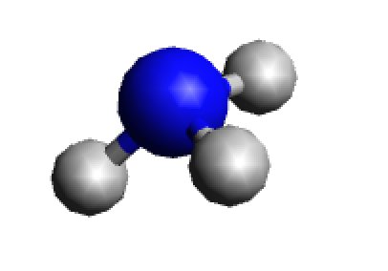

Energy levels in molecules
The energy levels describe how much energy a molecule has. In general, molecules would rather have the lowest energy possible (pretty chilled vibes)
Not a vibe
*
*
Energy
Know what? I don’t have to deal with this
E2
E2
sads :c
Yeet!
Oh.. Here we go again
What a day! No drama
See ya next year… or not
Hello… it’s me
E1
E1

Slide 19
Different types of EM radiation → Different molecular transitions
Ultraviolet and Visible
*
E2
E1
Electronic transitions
(electronic spectroscopy)

Slide 20
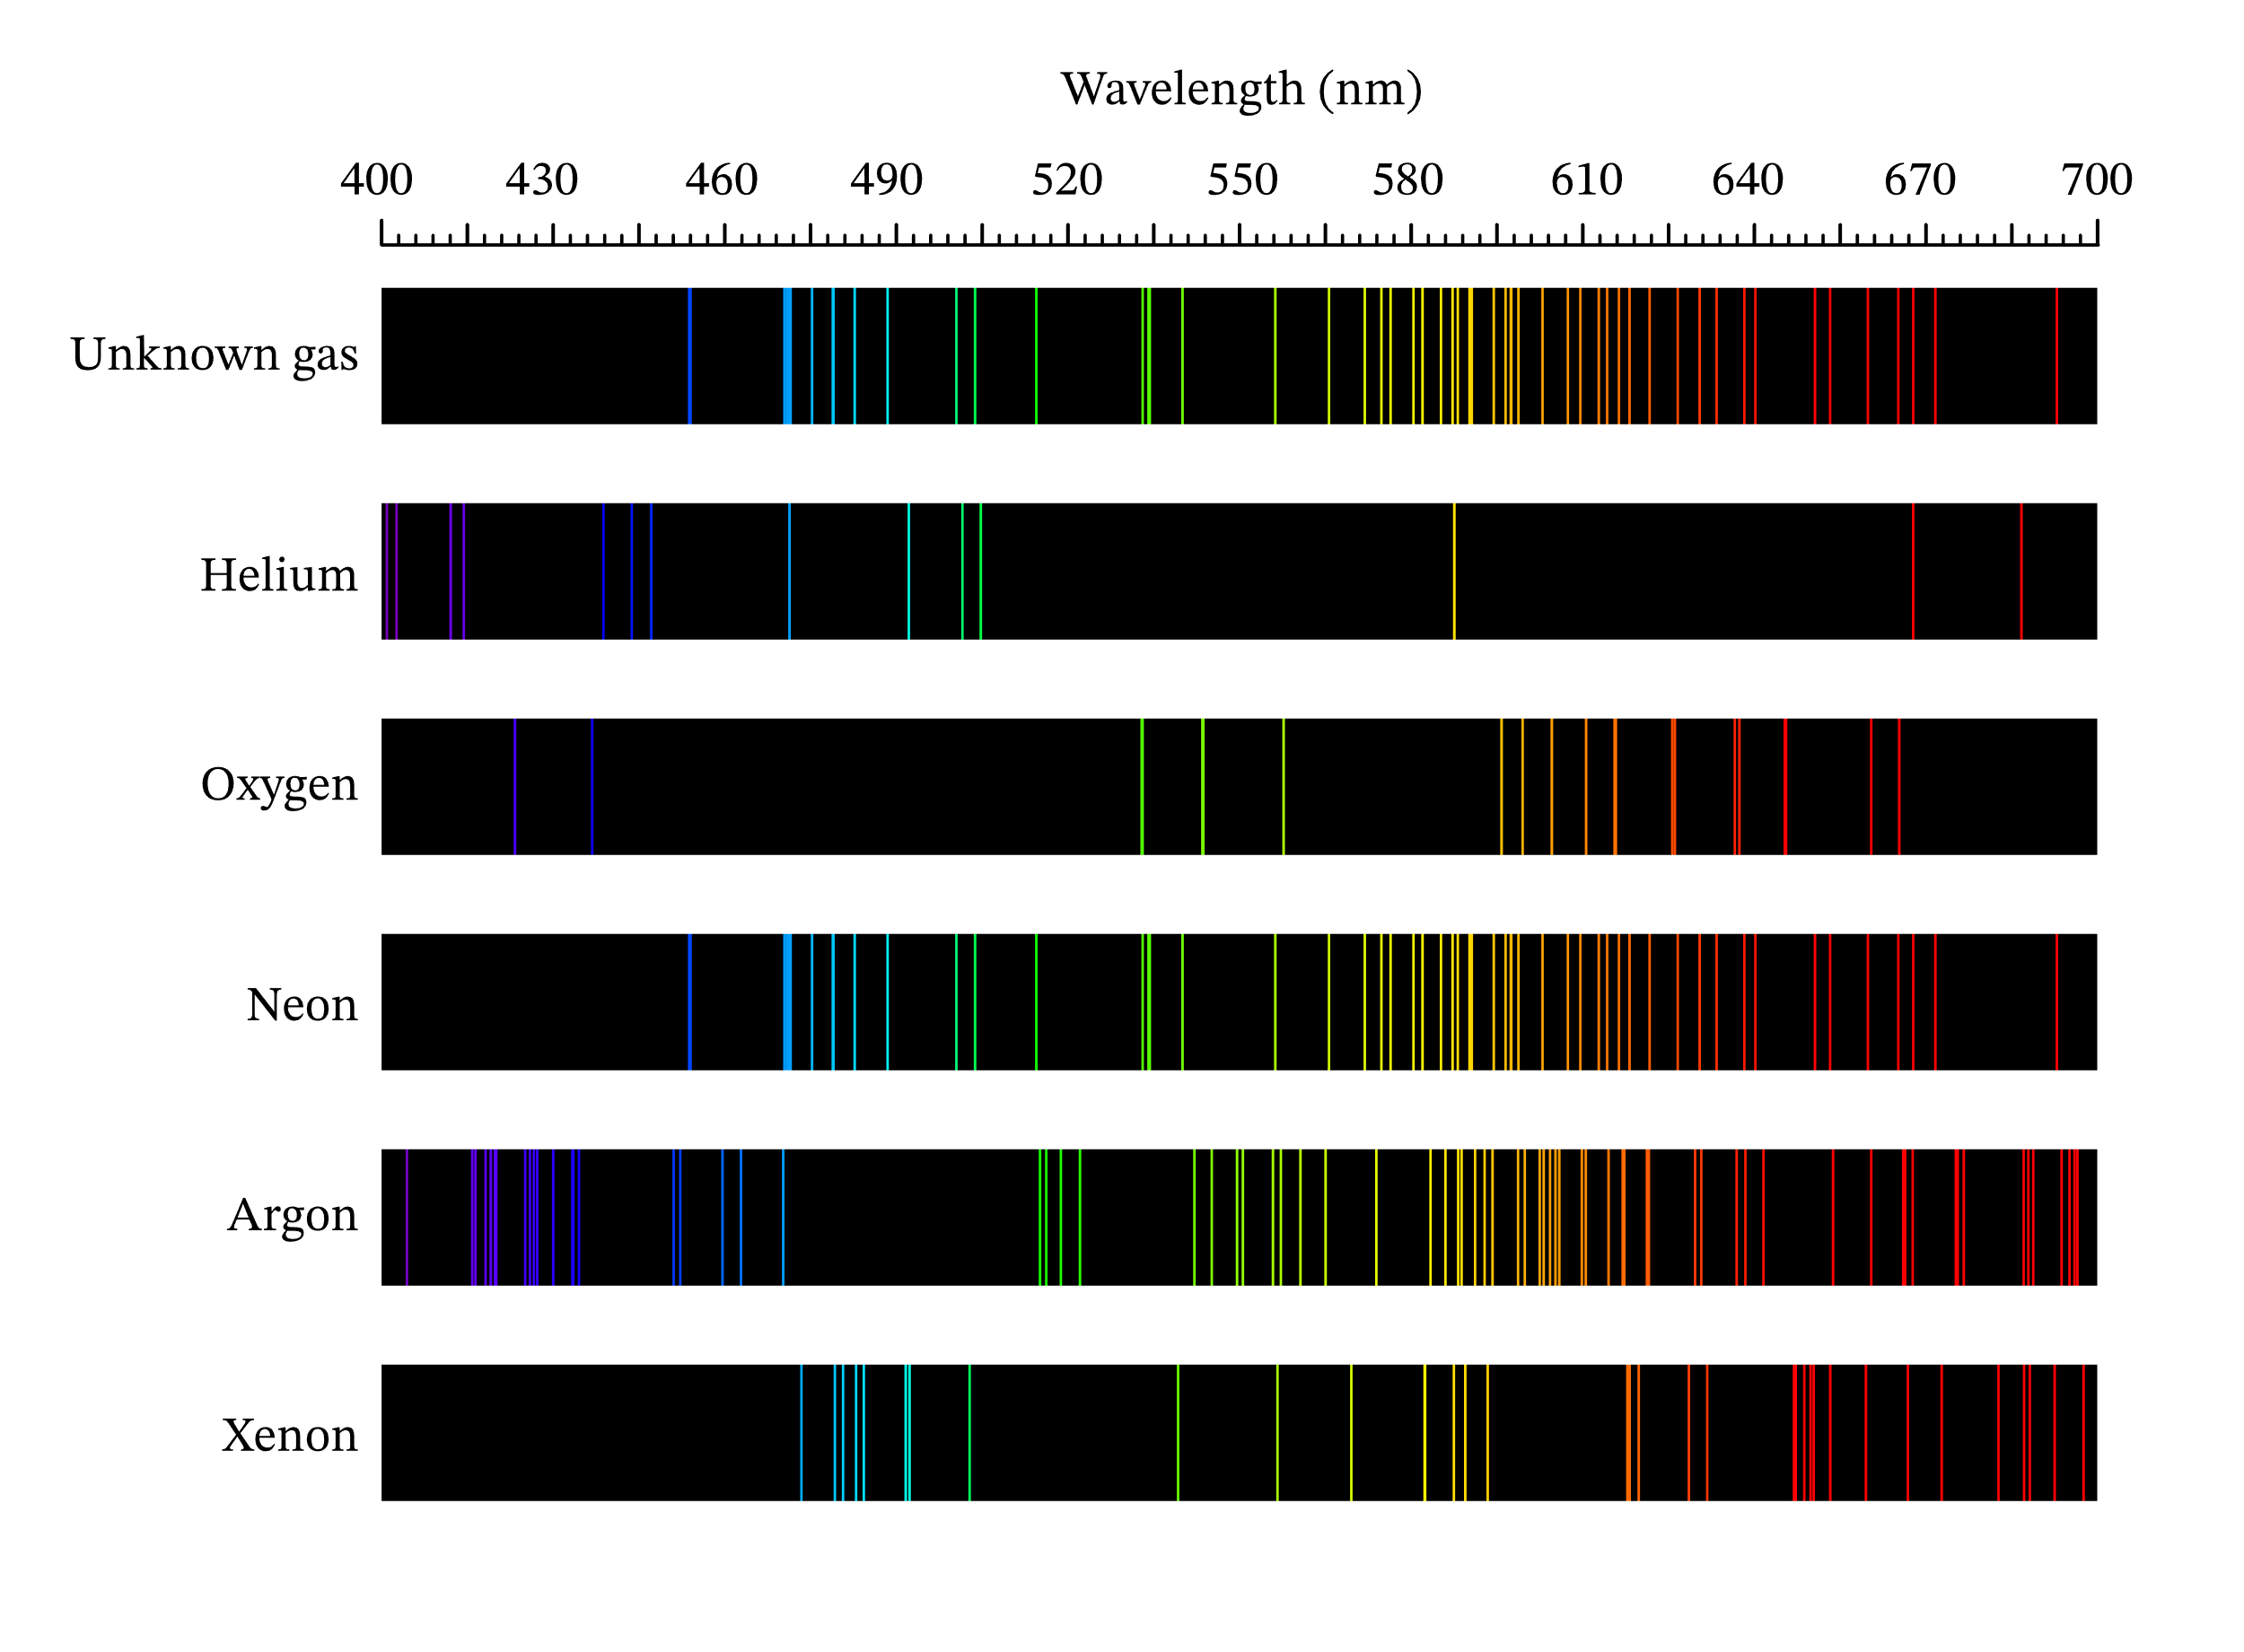
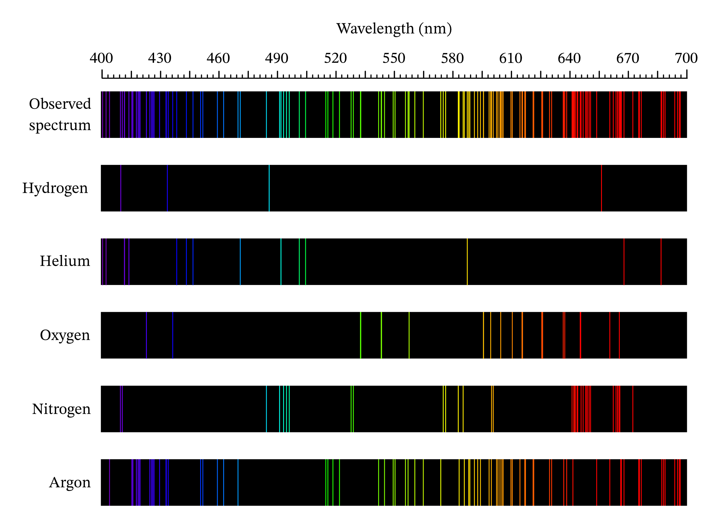
Wavelength (nm)
Helium
Oxygen
Nitrogen
Argon
Xenon
Neon
Sodium

Slide 21
Different types of EM radiation → Different molecular transitions
Ultraviolet and Visible
Infrared
Radio and Microwaves
*
E2
E1
Electronic transitions
(electronic spectroscopy)
Molecular vibrations
(IR spectroscopy)
Molecular rotations
(rotational spectroscopy)

Slide 22
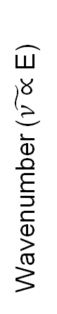
IR spectroscopy: Studying how molecules vibrate
Depending on the frequency (and hence the energy) of the radiation, molecules can vibrate in different ways
Symmetric O-H stretch
Wavenumber ($\tilde{ν∝}$ E)
Asymmetric O-H stretch
H-O-H bend

Slide 23
IR spectrum of water (H₂O)
All vibrational frequencies of a molecule are recorded in an IR spectrum
Intensity
Wavenumber (cm⁻¹)

Slide 24
Molecules vibrate when absorbing infrared radiation

Slide 25
You are going to simulate the process of searching for life Venus’ Atmosphere!

Slide 26
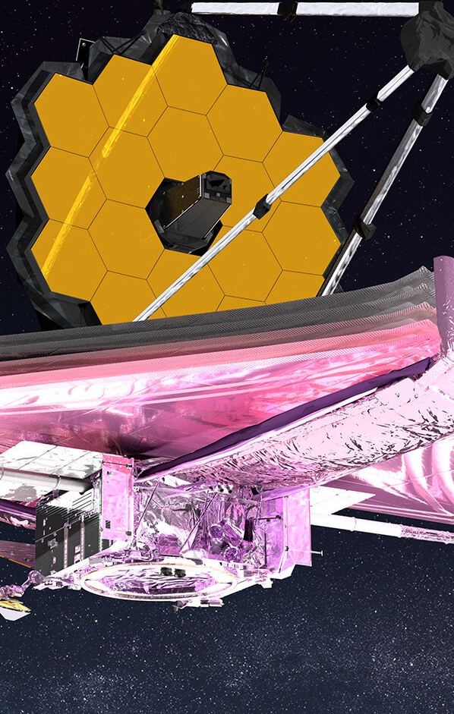
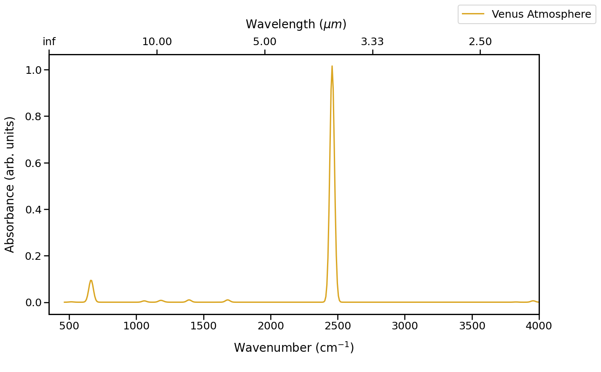
You are now all scientists!
You have just obtained a spectrum of Venus’ atmosphere from the JWST!
Simulated Telescope Venus Spectrum

Slide 27
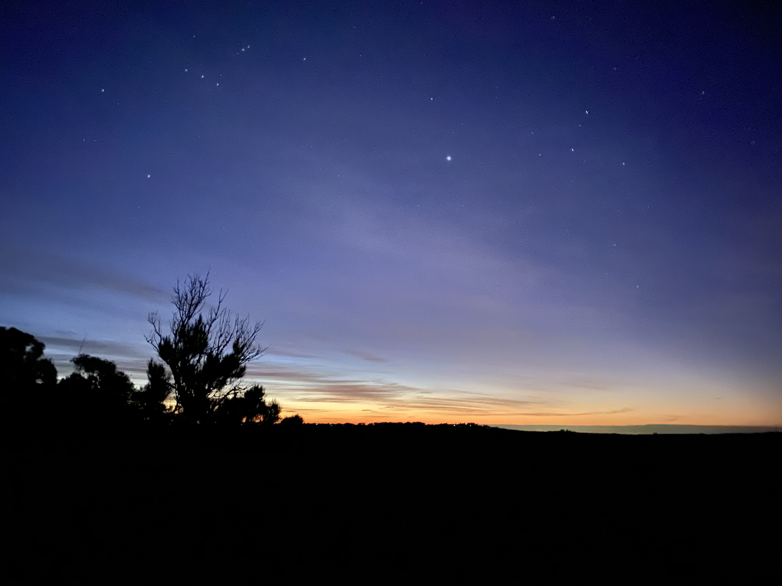
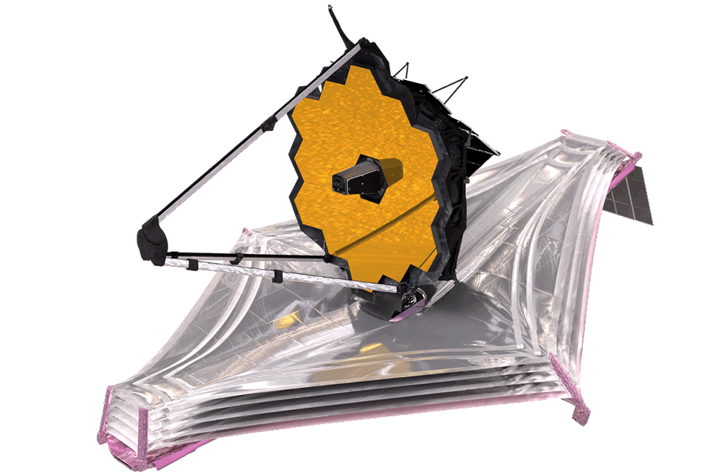
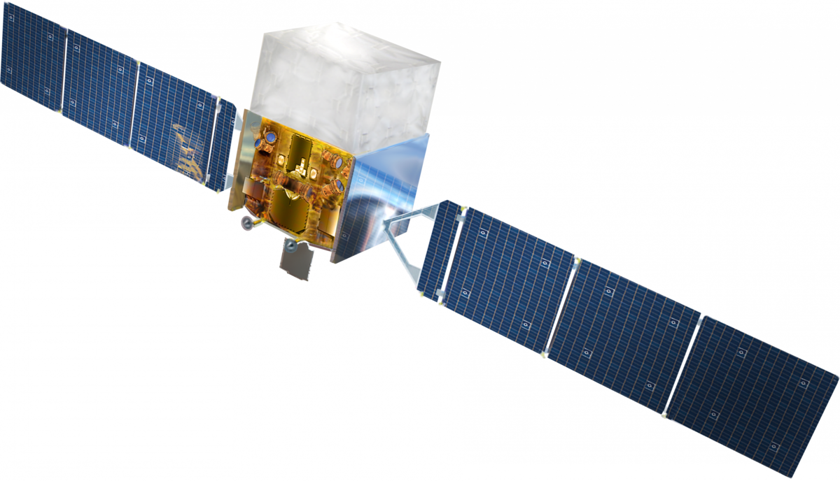
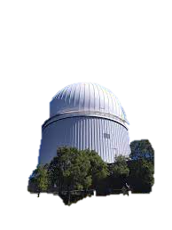
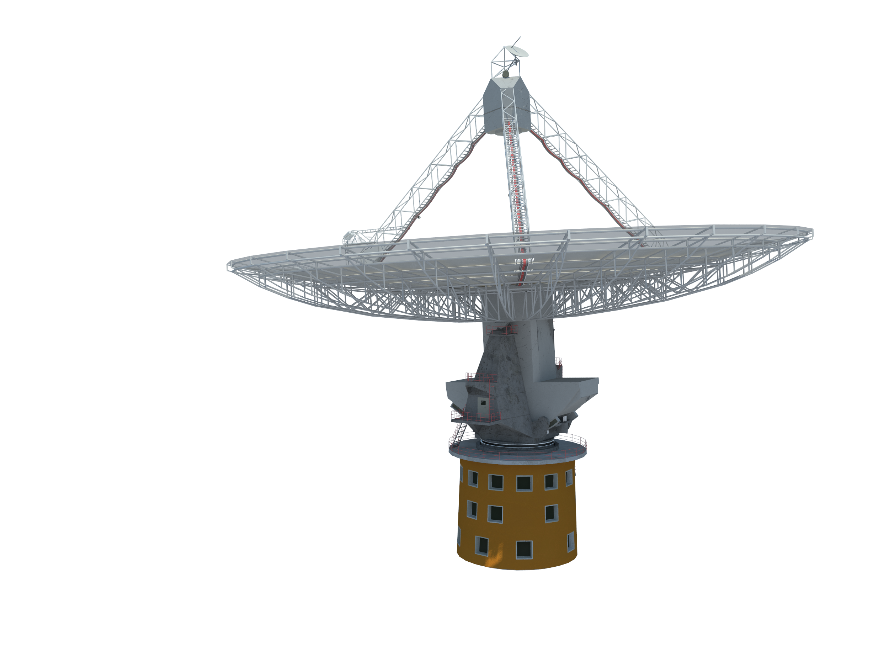
Gamma rays
X rays
UV
Visible
Infrared
Microwaves
Radio waves
Fermi Gamma-ray Telescope
James Webb Space Telescope
The electromagnetic spectrum
Anglo-Australian Telescope
Parkes Radio Telescope

Slide 28

Let’s Break-up into Science Teams
Each team is receiving simulated telescope data from a different spectrometer on the JWST!
Team MIRI
Team NIRSpec

Slide 29
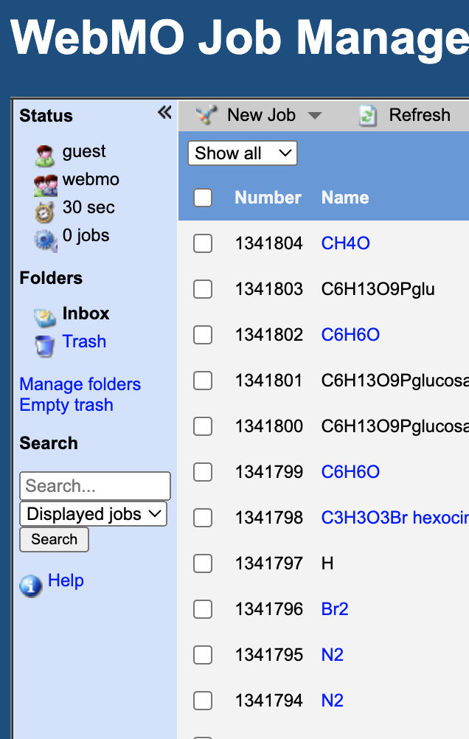
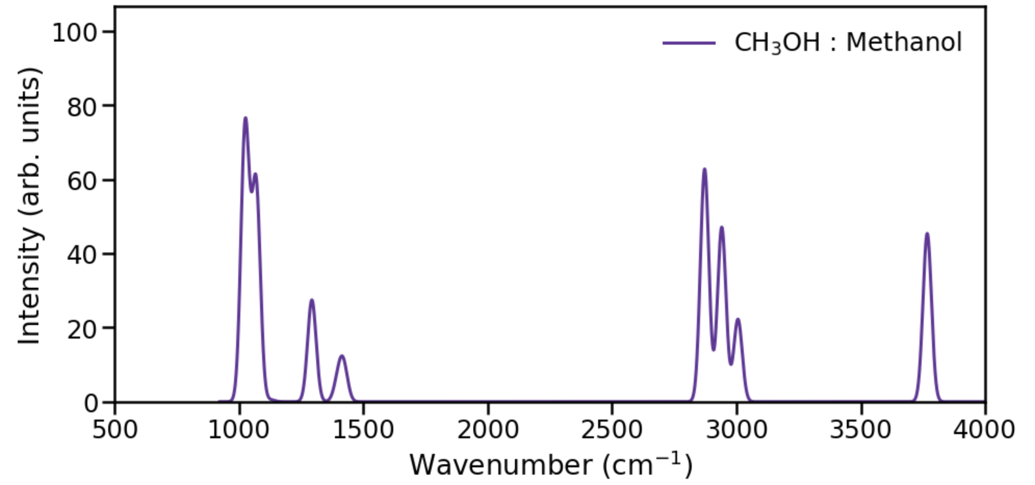
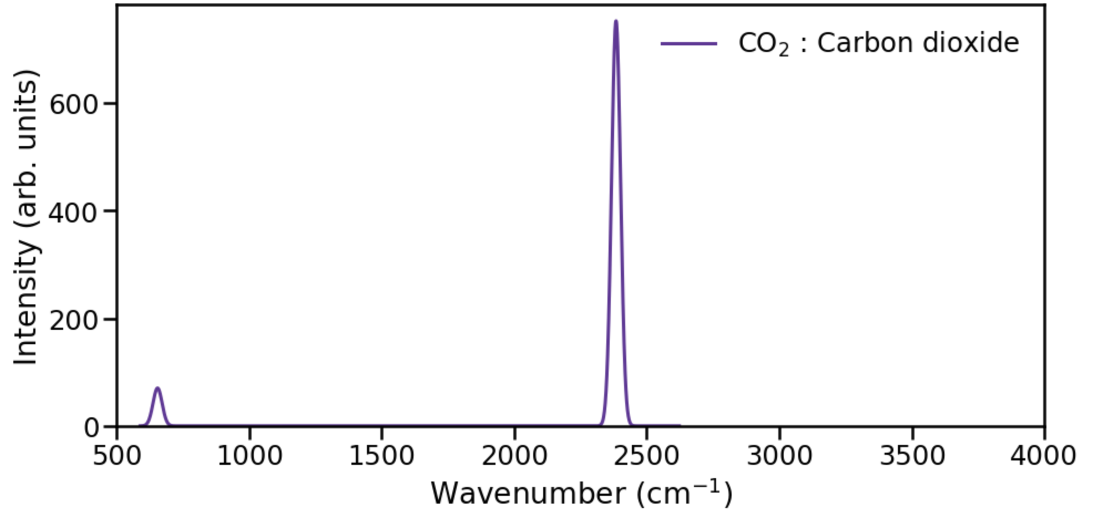
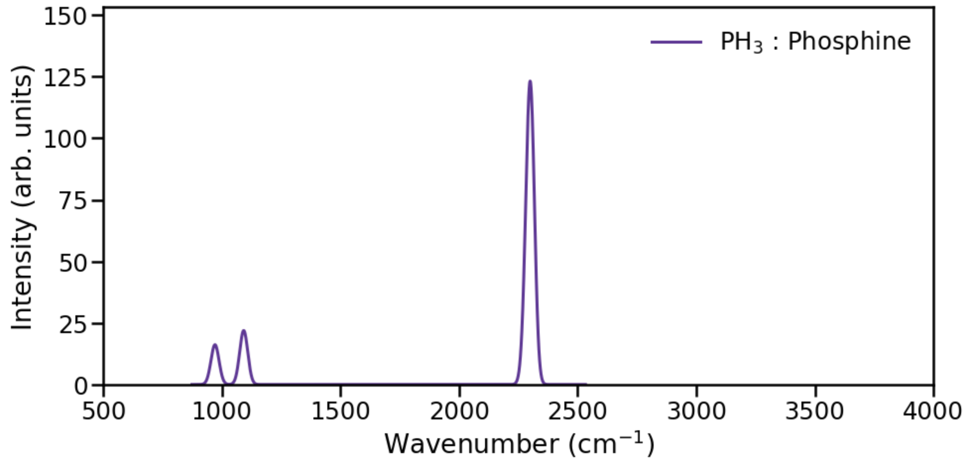
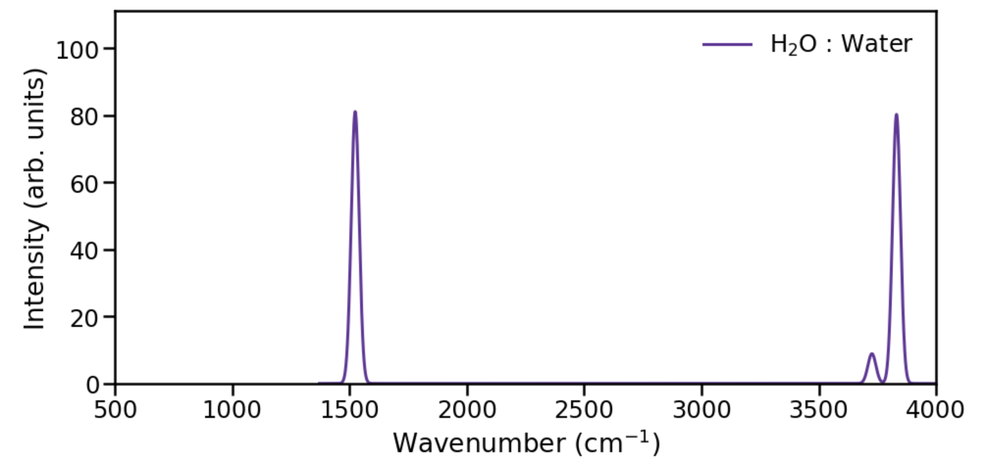
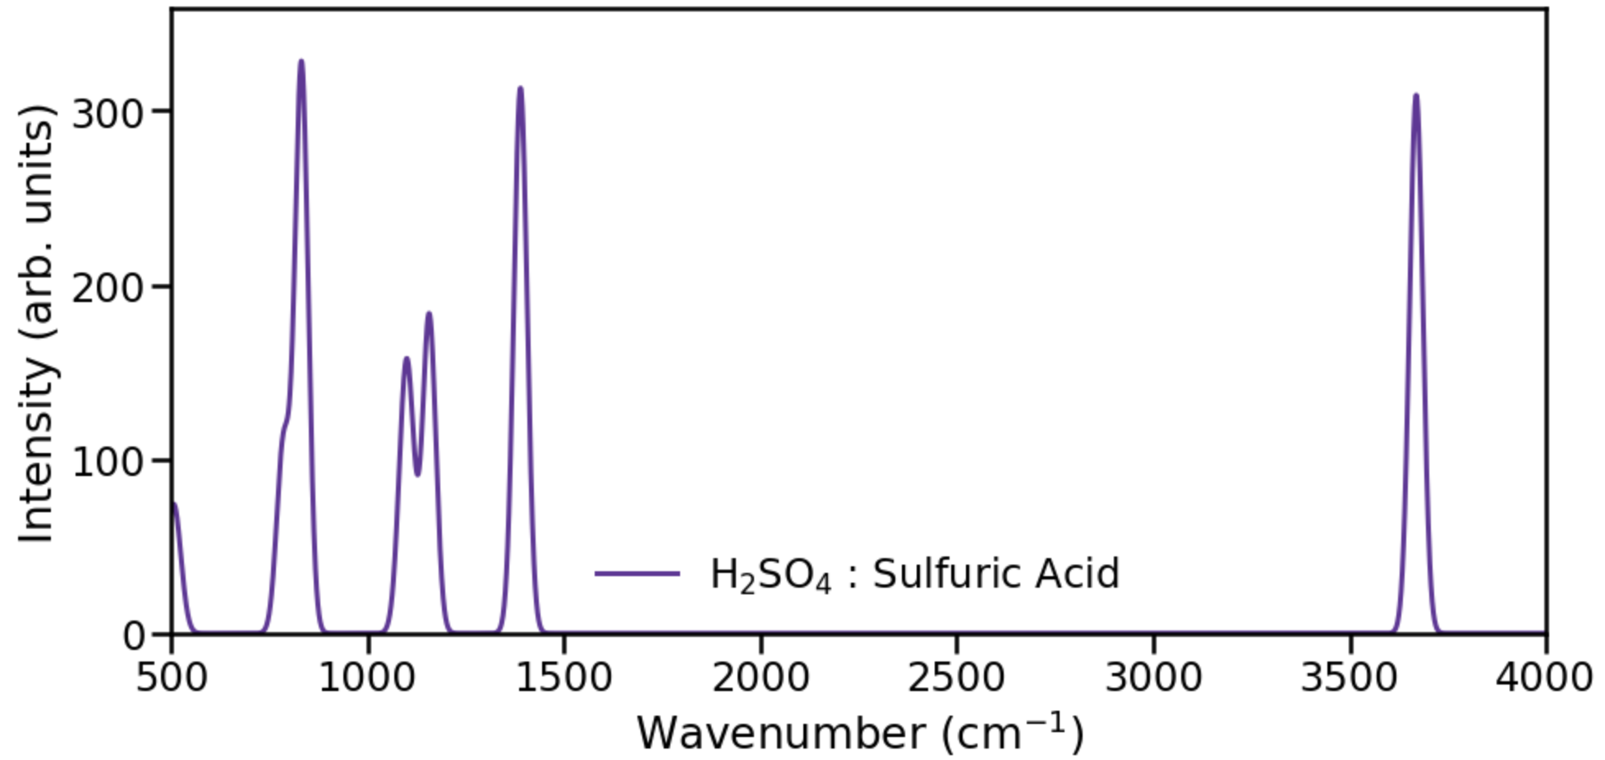
The Spectroscopy Tool
This afternoon you will generate spectroscopic data of phosphine!
Infrared Spectra
Computational Data Generation Tool

Slide 30
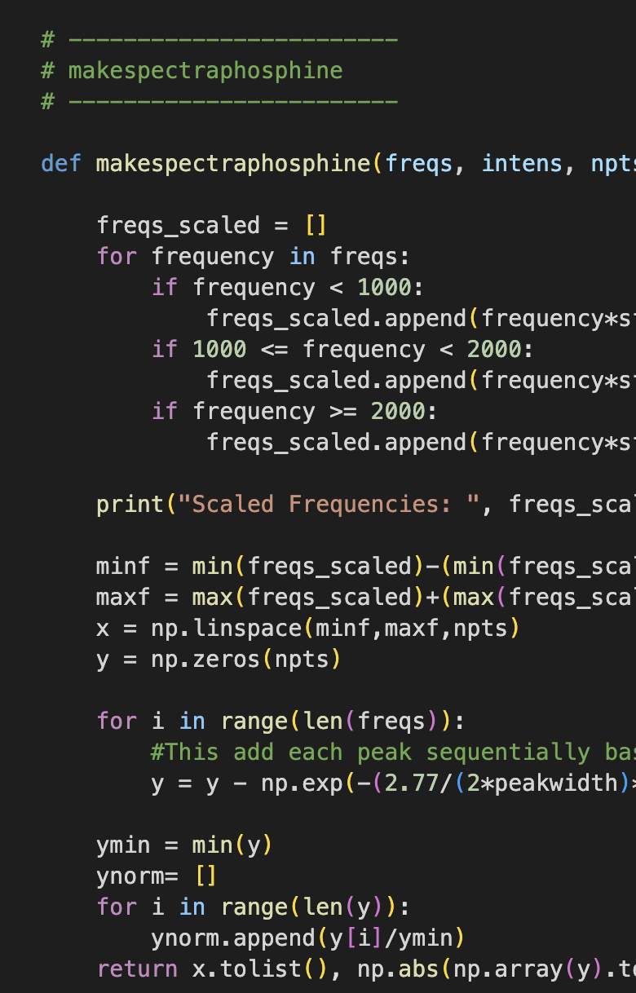
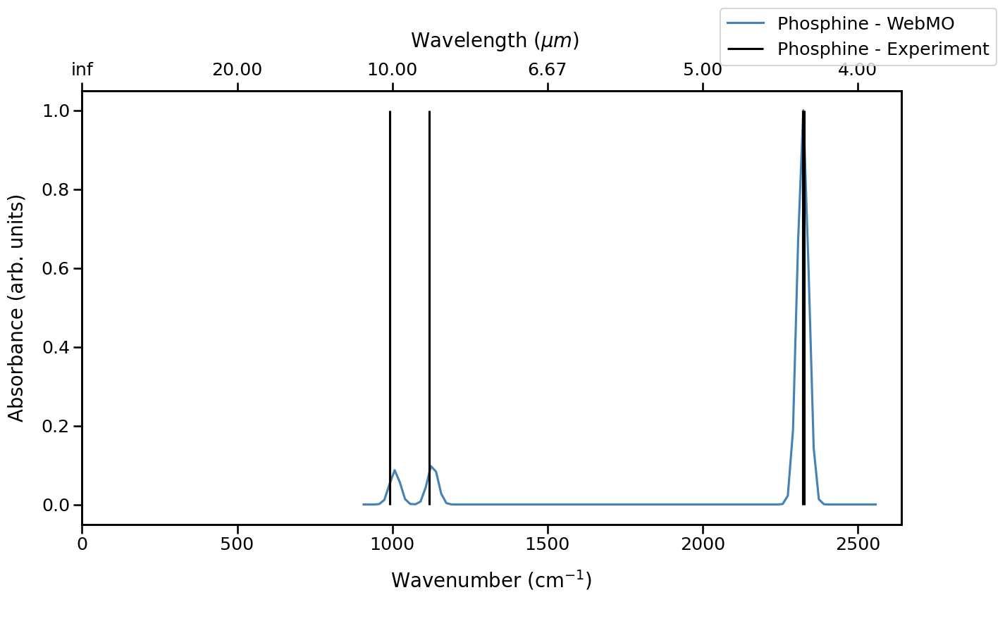
Data Analysis and Interpretation
You will be using ready-made code to anaylse and interpret your data!
Data Analysis Code
Don’t worry, you don’t need to know how to code!

Slide 31
You are now all scientists!
Goal: Search for phosphine in the atmosphere of Venus with spectroscopy!
Simulated Telescope Venus Spectrum
Computational Data Generation Tool
Data Analysis Code

